Slide 1
Upskilling adult educators AdUP Resources for adult educators in the field of didactics 3rd email campaign

Slide 2
UNIMC (Italy)
VHS CHAM, (Germany)
PROMEA (Greece)
APRC (Lithuania)
VAEV (Austria)
PARTNERSHIP

Slide 3
OBJECTIVE
To enhance adult educators in terms of learner motivation and engagement and provide a comprehensive framework of assessment and corresponding improvement of adult educators’ performance in the field of didactics.
Improvement
Effective communication
Self-reflection
Different learning methods
Knowledge
Styles and techniques

Slide 4
PROJECT GOALS
Develop and provide tools to improve the assessment of adult educators’ knowledge, skills and competences in the field of didactics for adult education.
Increase adult educators’ performance regarding learner motivation and engagement through project training activities and resources.
Share recommendations enabling adult education providers to assess and improve their workforce's didactics competences.

Slide 5
PROGRESS SO FAR
The AdUp moduar course developed:
- 5 learning units, corresponding to specific learning
outcomes, developed;
- the course curriculum, supplemented with
methods, learning experience and assessment
guidlines, evolved;
- the course curriculum translated into 4 languages
(German, Greek, Italian and Lithuanian);
- training and assessment materials built up;
- the course curriculum uploaded onto the project
website ( https://adup.aprc.lt/wp-content/uploads/2022/10/ADUP-IO2-T2-
Development-of-the-course-curriculum_IT.pdf);

Slide 6
PROGRESS SO FAR
The course materials from 5 modular units pilot tested in LTTA;
The learning units and contextualised training and assessment materials integrated into a Massive Open Online Course (MOOC) and uploaded onto the thinkific platform (https://erasmusmoocs.thinkific.com/courses/adup).

Slide 7
NEXT STEPS
Output 3
Development of additional MOOC learning materials.
Pilot run of the AdUp Diagnostic Tool and MOOC.
Finalisation of the AdUp MOOC.
Output 4
Development of the AdUp Certificate Supplement;
Recommendations Paper;
Composition of a Statement of Support (SoS).

Slide 8
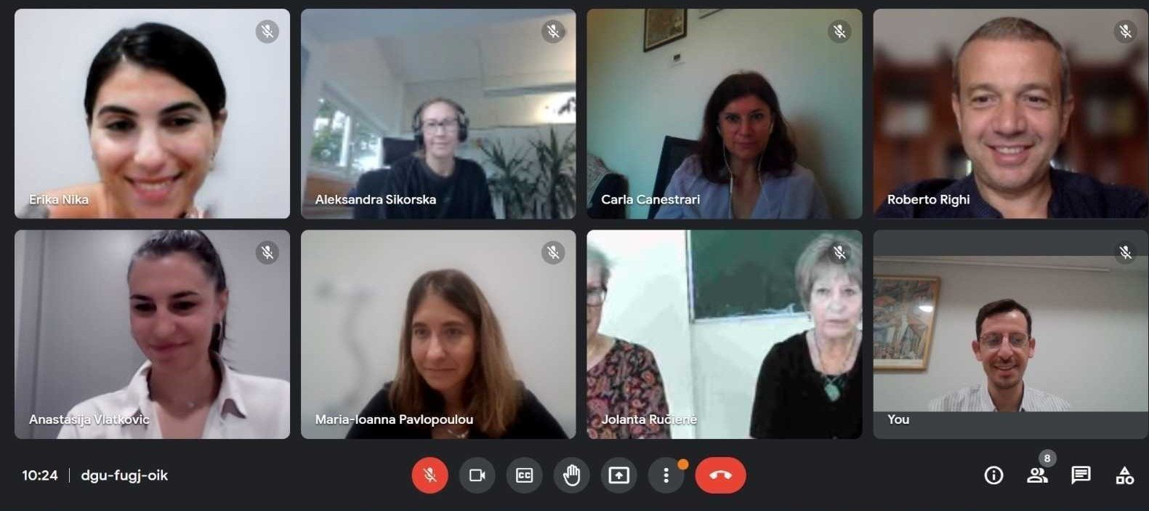
SOME EXTRA INFO
PARTNERSHIP MEETING
The Extra Transnational hybrid project meeting, hosted by the Greek partner PROMEA, was held on 15 -16 September 2022.
We discussed:
The finalisation of IO2;
The preparation for upcoming LTTA in VHS, Cham;
The development and delivery of the AdUp MOOC;
The additional MOOC learning materials.

Slide 9
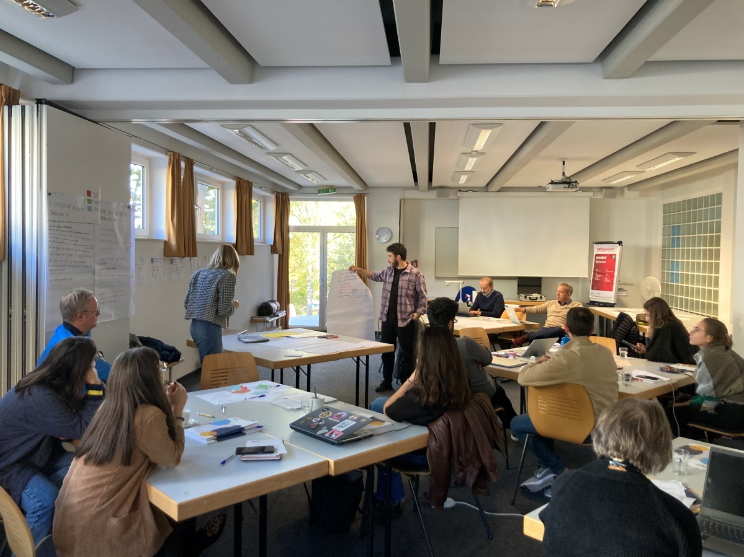
SOME EXTRA INFO
TRANSNATIONAL TRAINING EVENT
The three-day LTTA, organised by VHS in Cham, Germany, was arranged on 5-7 October, 2022.
Interactive workshops using the IO2 materials conducted;
The specific factors that impend effectiveness in motivating and engaging adults in learning activities discussed;
Experience in using the AdUp resources gained (30 participants from UNIMC, VHS CHAM, PROMEA, VAEV and APRC took part in the training);
The MOOC platform and some additional training materials presented.

Slide 10
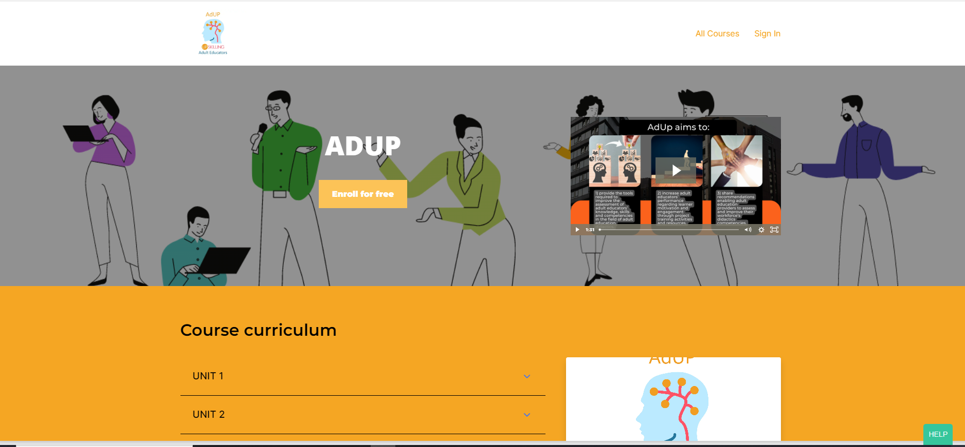
SOME EXRTRA INFO
MASSIVE OPEN ONLINE COURSE (MOOC)
https://erasmusmoocs.thinkific.com/courses/adup
The AdUP MOOC, with the structure reflecting the curriculum’s structure, as defined in the previous Output, developed.
The online course, organized around learning units and lessons comprising the project’s training and assessment materials, contextualised in an online form (text, presentations, multimedia files, interactive tools and exercises).
Some additional teaching materials uploaded.

Slide 11
Thank you!
Visit the AdUp website
Follow AdUp on Facebook
Connect with AdUp on LinkedIn
Tweet @ the AdUp project

